Slide 1




Flutter – Lecture 9

Slide 2
Topics to be Covered
We will Cover :
ListView
ListTile
GridView

Slide 3
ListView
There are different types of ListViews:
Multi-child Layout widget
The default behavior of ListView, normally use for display a small number of children. Use it to display a static list of children whose count don’t change. Basic structure of this listview is
ListView(
children: [
child widget1,
child widget2,
.....
],
scrollDirection: Axis.horizontal,
)
Notes:
ListView is a list of scrolling widgets. which displays its children one after another in scroll direction.

Slide 4
Properties of ListView
padding:- padding: EdgeInsets.all(10)
shrinkWrap:- It should be true to save memory wastage and increase app performance.
shrinkWrap: true
reverse:- Use this property to display the list in reverse order.
reverse: true
scrollDirection:- Use this property to change the scroll direction of the ListView. Default is Axis.vertical.
scrollDirection: Axis.horizontal,
itemExtent:- Use this property to extend (increase) the item in scroll direction. When the scroll direction is vertical it increases height and when vertical it increases the width of the item.
itemExtent: 100,

Slide 5
ListView.builder
Use this constructor to generate the ListView dynamically or with data from API (backend).
itemBuilde: it is an important property of ListView.builder. We use this property to generate the children for the listview.
itemCount: use to improve the ability of the ListView to estimate the maximum scroll extent.
Notes:
The main difference between ListView and ListView.builder is that ListView creates all items at once, whereas the ListView.builder() constructor creates items when they are scrolled onto the screen.

Slide 6
ListView.builder
return ListView.builder( itemBuilder: (BuildContext context, int index) { return ListTile( title: Text('This is title'), subtitle: Text('This is subtitle'), trailing: Text('This is trailing'), leading: CircleAvatar(backgroundImage: AssetImage(imgList[index]),), ); }, itemCount: imgList.length, shrinkWrap: true, padding: EdgeInsets.all(10), );
Notes:
ListView.builder() is used to render long or infinite lists, especially lists of data fetched from APIs like products, news, messages, search results… Only visible items of the lists are called to reduce resource (CPU, RAM) consumption and improve performance.

Slide 7
ListView.Seperated
To display a listview with separators / dividers.
It is almost similar to listView.builder() but it has an extra property separatorBuilder, which is used to build separator to the items of the listview.
separatorBuilder: (BuildContext context, int index) {
return Divider(height: 5,);
},
Notes:
n Flutter, you can use ListView.separated to easily create a list view whose items are separated by separators (or dividers). A separator only appears between two list items and never stands before the first or sits after the last item.

Slide 8
ListTile
It can be use to display icons (in leading or trailing position) and text in a card. It contains one or three lines of text (title, subtitle) optionally flanked by icons or other widgets, such as check boxes.
List tiles are typically used in ListViews, or arranged in Columns in Drawers and Cards.
ListView( children: [
ListTile( leading: Icon(Icons.map)
//Or leading: CircleAvatar(backgroundImage: AssetImage('assets/img3.jpg')), title: Text('Apple'), ),
ListTile(…),
ListTile(…),
],
);

Slide 9
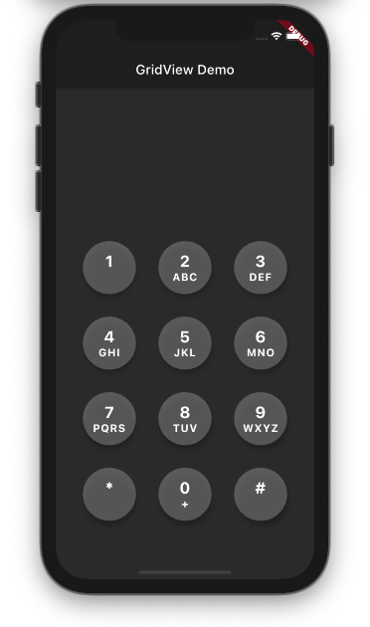
GridView
GridView is a widget that displays a list of items as a 2D array. In simple terms, the items are shown in a table format.
It is multi-child layout widget
We can display images, text, icons, etc on GridView.

Slide 10
GridView
GridView can be implemented by
GridView.count():- This constructor enables you to create a GridView with a fixed number of items.
GridView.builder(): To show a long list or an infinite number of items that may come from the database.
GridView.custom(): Use this constructor to make your own custom GridView.
GridView.extent(): Use when we want to create a grid with custom extent values. It means each tile has a maximum cross-axis extent.

Slide 11
GridView Properties
crossAxisSpacing: Setting a value for this property allows you to place a space between items on the cross axis.
mainAxisSpacing: The main axis refers to the axis in which the list scrolls.
scrollDirection: This change the scroll direction
Physics: This property allows you to set the scroll behavior for the list.
shrinkWrap: Setting the shrinkWrap value to true causes GridView to take only the required space to fill items in the scroll direction. This defaults to false

Slide 12
Summary
Today we have learned about:
ListView – Properties, Builder, Separator/Divider
ListTile
GridView - Properties

Slide 13
In Next Lecture:
We will Cover in more detail:
Scaffold Widgets
Scaffold Properties

